Slide 1

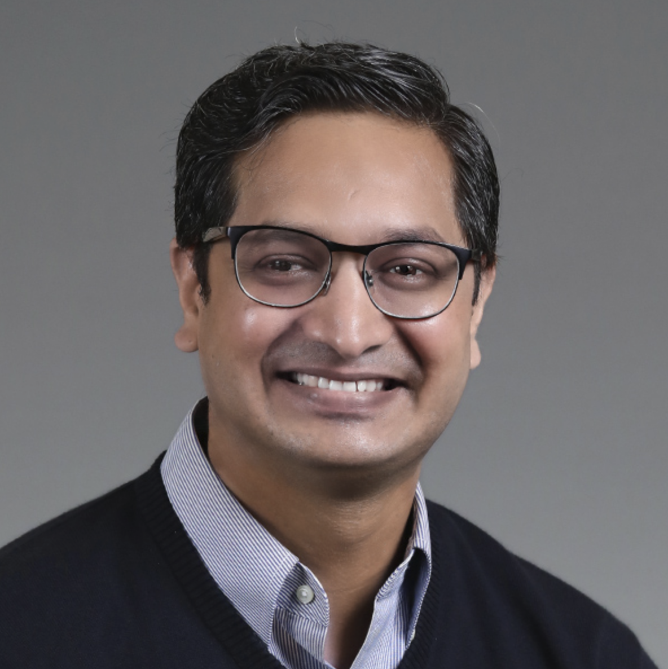
Workshop
Mastering Stable Diffusion
Module 5
Stable Diffusion Task to Achieve Purpose at hand
Sandeep Singh
Head of Applied AI, Beans AI

Slide 2

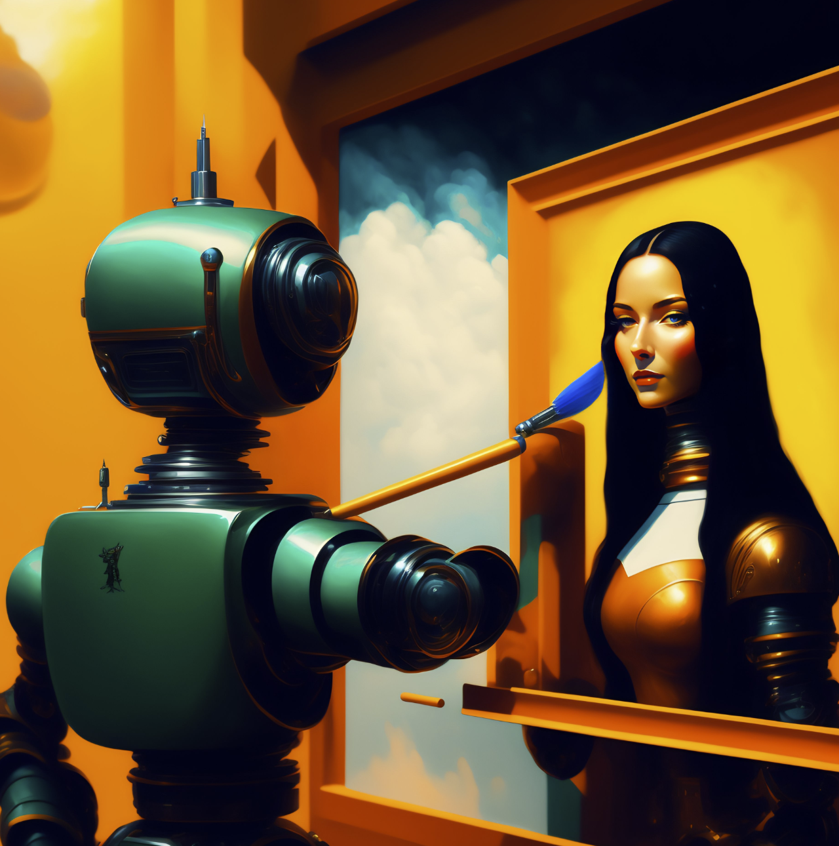
Module 5 Purpose
Theme of this MOST APPLIED module is: Find and Use the Type of Stable Diffusion Application Needed to Achieve the Results.
img2img: Categorical Intuition
Image In-Painting: Various forms and factors.
Image Editing with img2img Sketch.
Image Editing with In-Paint Sketch.
CIVITAI: Introduction and fine-tuned models.
Stable Diffusion: Model Zoo and Extensions.
MidJourney: The Storm, The Story, The Inspiration.
MidJourney: How to exploit MidJourney .
Adobe Firefly: Introduction and Demo
Microsoft Designer: Introduction and Demo
OpenAI DallE-2: Introduction and Demo
Blue Willow: Introduction, Demo and Warnings.
Lexica Art Prompt Learnings.

Slide 3
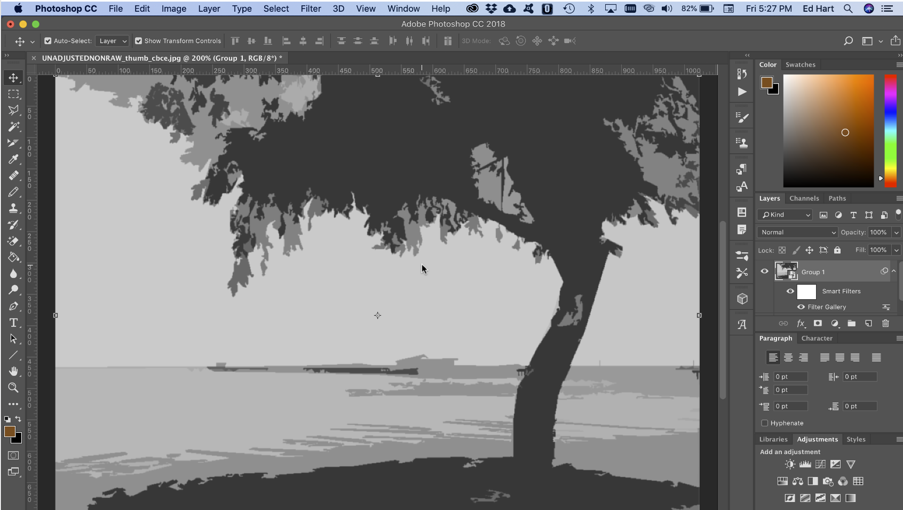
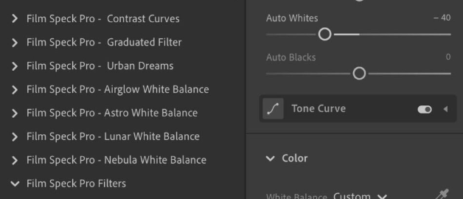
img2img: Categorical Intuition
Image 2 Image is a whole lot wide category of techniques based of Diffusion Models.
Stochastic nature of Stable Diffusion makes it hard to create exact image needed.
Image 2 Image enables image editing techniques, available only to pros till now.
Opens a new way of creative process, which light weight and creativity driven.
Technical friction to image editing have been reduced by great extent.

Slide 4
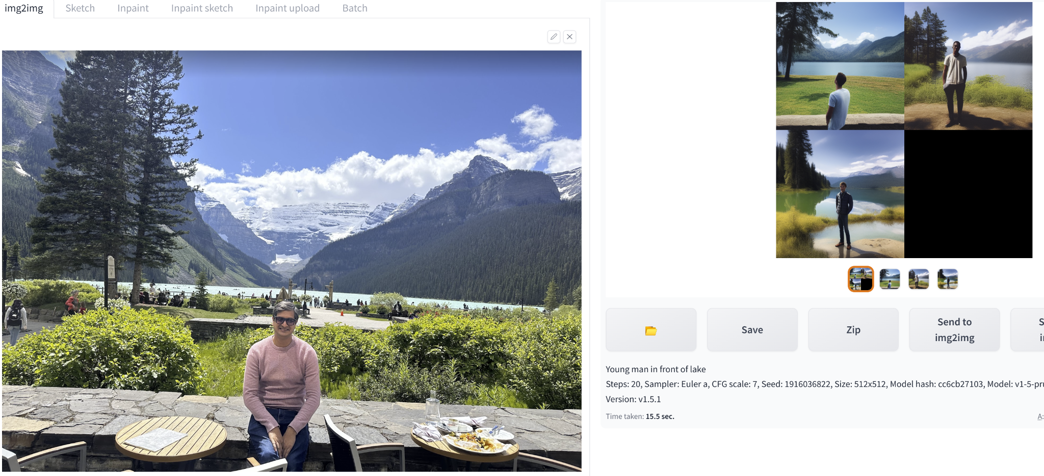
Img2img: transform img with Text Only
Leads to lots of undesired editing artifacts, So, text only image editing it rarely useful. It is as good as text to image generation! Hence, we need more sophisticated way!

Slide 5
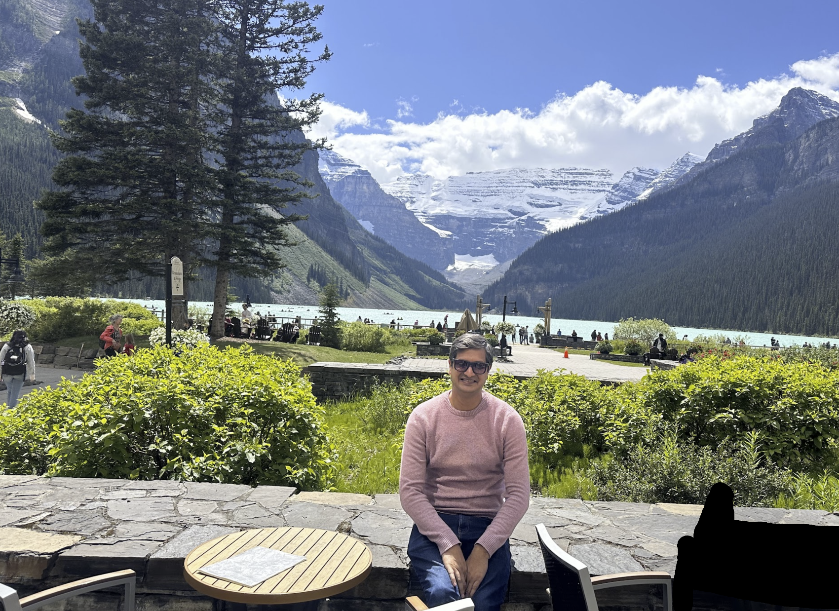
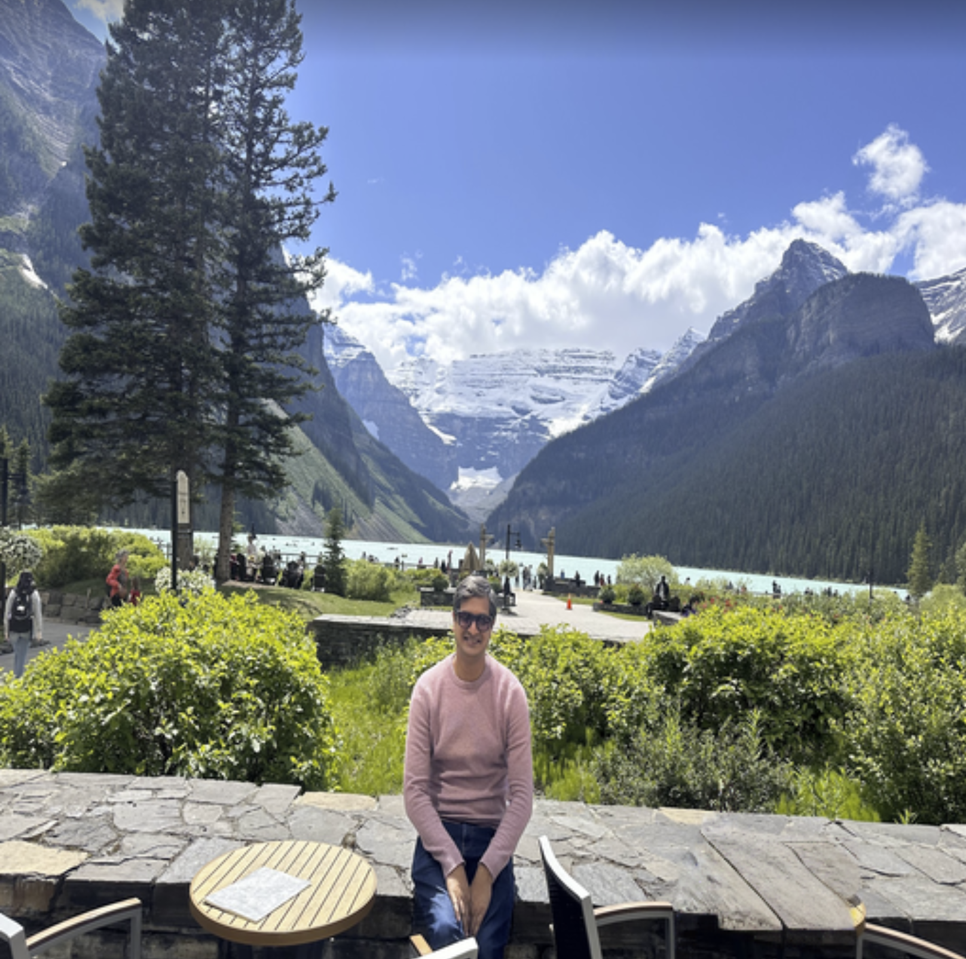
Img2img: transform img with Inpainting
Works much better and have controlled editing capabilities. E.g. Removed artifacts from lower-right.

Slide 6
Img2img: Terminology: CFG Scale
:
Classifier Free Guidance Scale
CFG Scale: Parameter that controls how much the image generation process follows the text prompt.
The higher the value, the more the image will stick to the given text input.
CFG Scale always should not be set to the maximum, as:
more guidance can lead to less diversity and quality.
Good Range: Between 7 and 13 are a good starting point for the CFG Scale.
Increase: Generated images are not following the text prompt closely enough.
Decrease: Generated images are becoming too repetitive or low-quality.
Note:
Sweet spot for CFG Scale needs to be searched.
CFG Scale is not the only parameter that can be used to control the generated images.
Other parameters matter as well, such as the number of diffusion steps and the temperature etc.

Slide 7
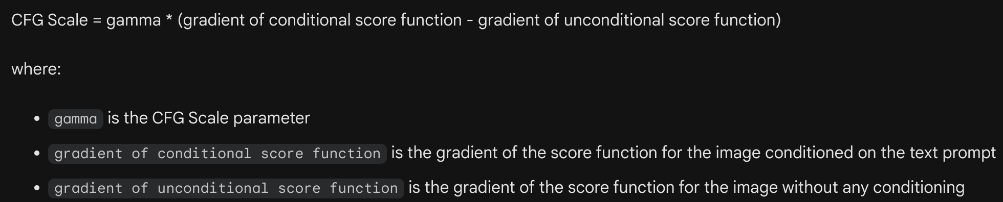
Img2img: CFG Scale Math Intuition
Classifier Free Guidance Scale is: The higher the gradient, the more sensitive the image is to changes in the input noise.
The CFG Scale effectively amplifies the gradient of the conditional score function, which makes the image more sensitive to changes in the text prompt. This can help to ensure that the generated images are more likely to match the text prompt.

Slide 8
Img2img: Terminology: Denoising Strength
:
Denoising Strength
Denoising Strength: Controls how much noise is removed from the input image during the each denoising step. .
The higher the value, the more noise is removed, resulting in a cleaner image.
Denoising Strength always should not be set to the maximum, as:
can also lead to the image losing some of its details.
Good Range: Between 0.5 and 0.8 are a good starting point. .
Increase: Generated images are not following the text prompt closely enough.
Decrease: Generated images are becoming too repetitive or low-quality.
Note:
Sweet spot for Denoising Strength needs to be searched.
Denoising Strength is not the only param that can be used to control the generation.
Other parameters matter as well, such as the number of diffusion steps and the temperature etc.

Slide 9
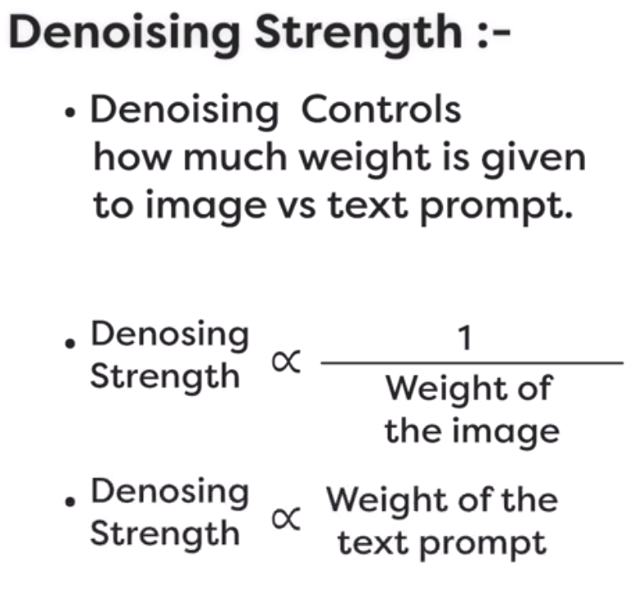
Img2img: Terminology: Denoising Strength

Slide 10
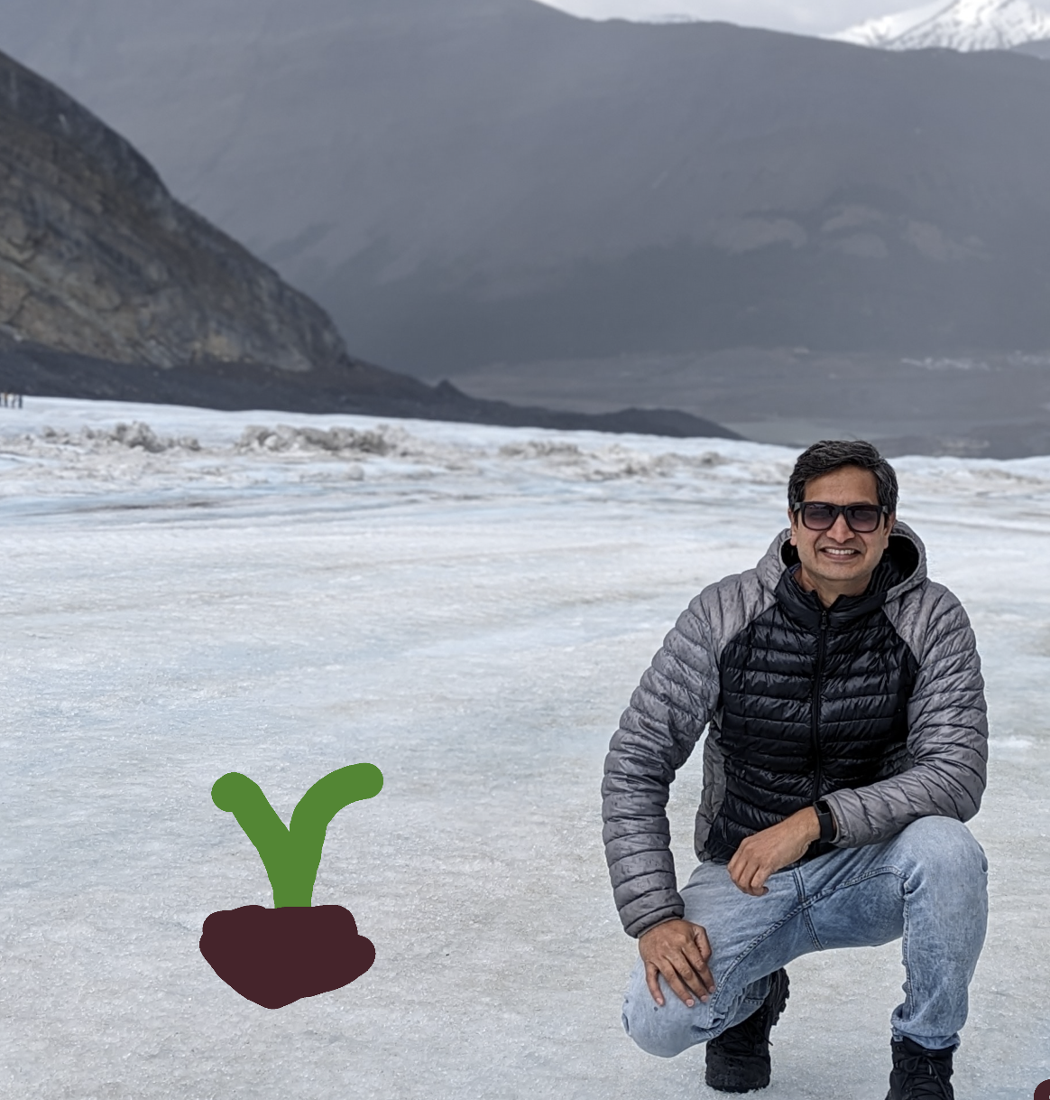
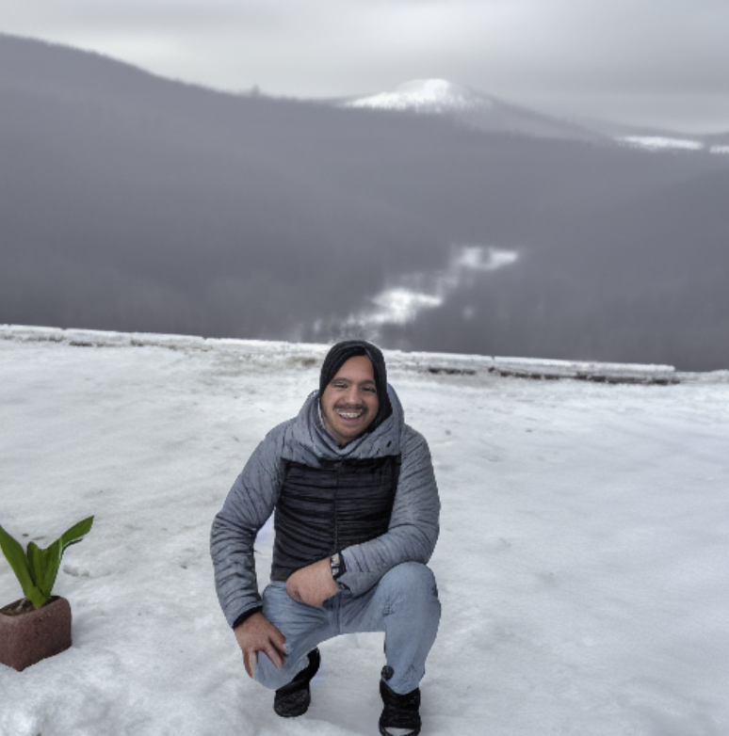
Img2img: Sketch
Much more finer control over editing and introduction of new concepts.

Slide 11
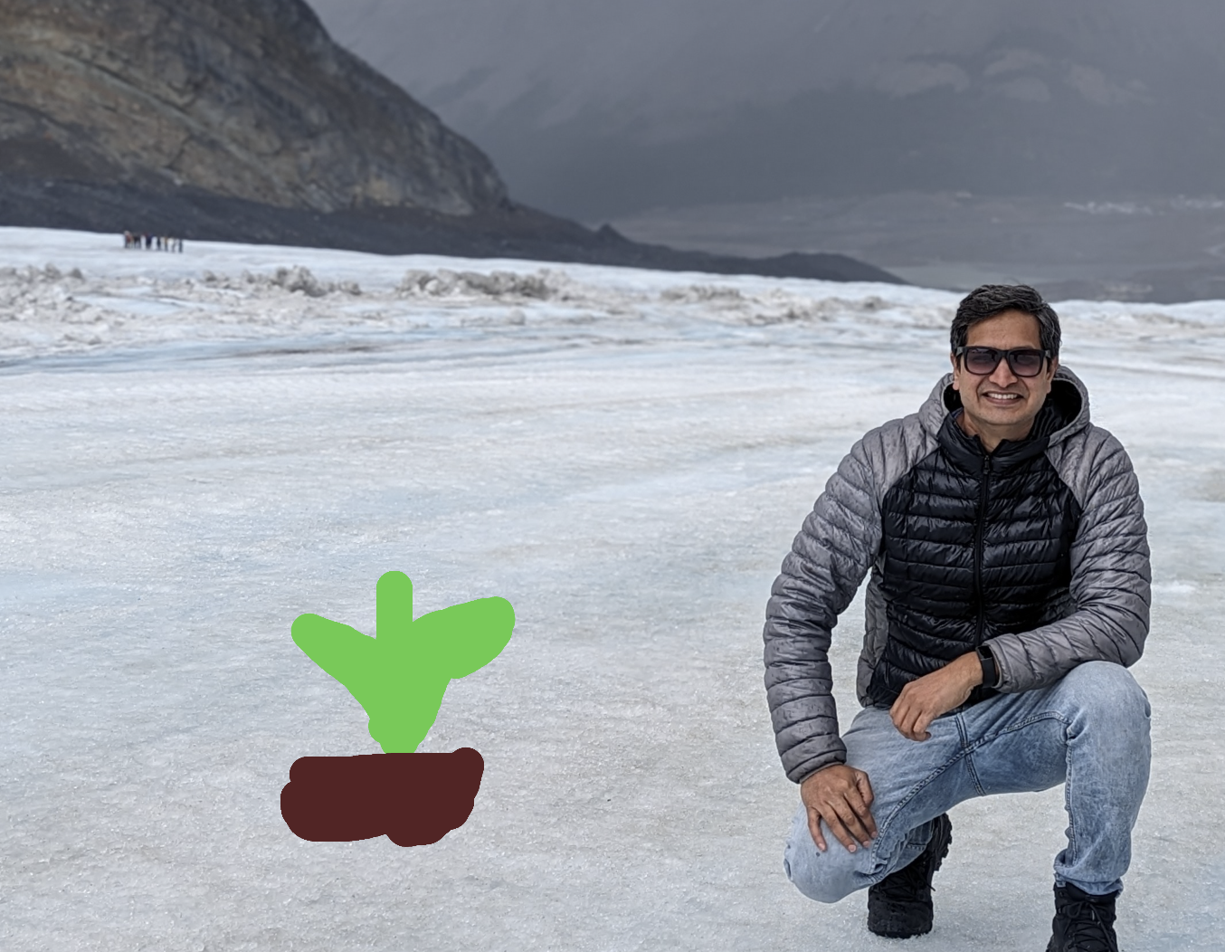
Img2img: Inpainting + Sketch
Much more finer control over editing and introduction of new concepts.
You give schematic of concept to be generated and that drives the generation. E.g. Paint the line diagram to of plant to generate that type of tree. (more in demo)

Slide 12
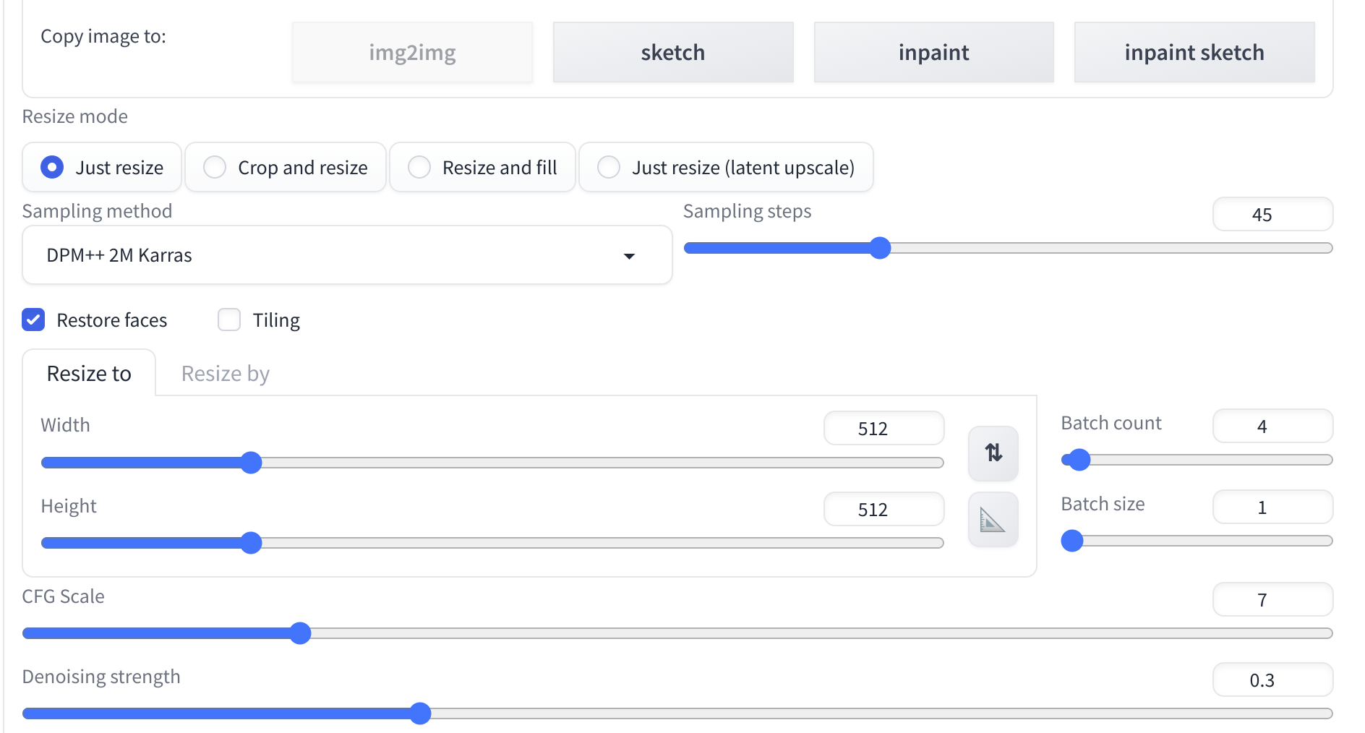
Img2img: Demo
Demo :
Img-2-img: Text Only
Img-2-img: Text Plus Mask
CFG Scale and Denoising
Restore Faces
Samplers
Batch Count
Face-replacement
Inpaint Sketch

Slide 13
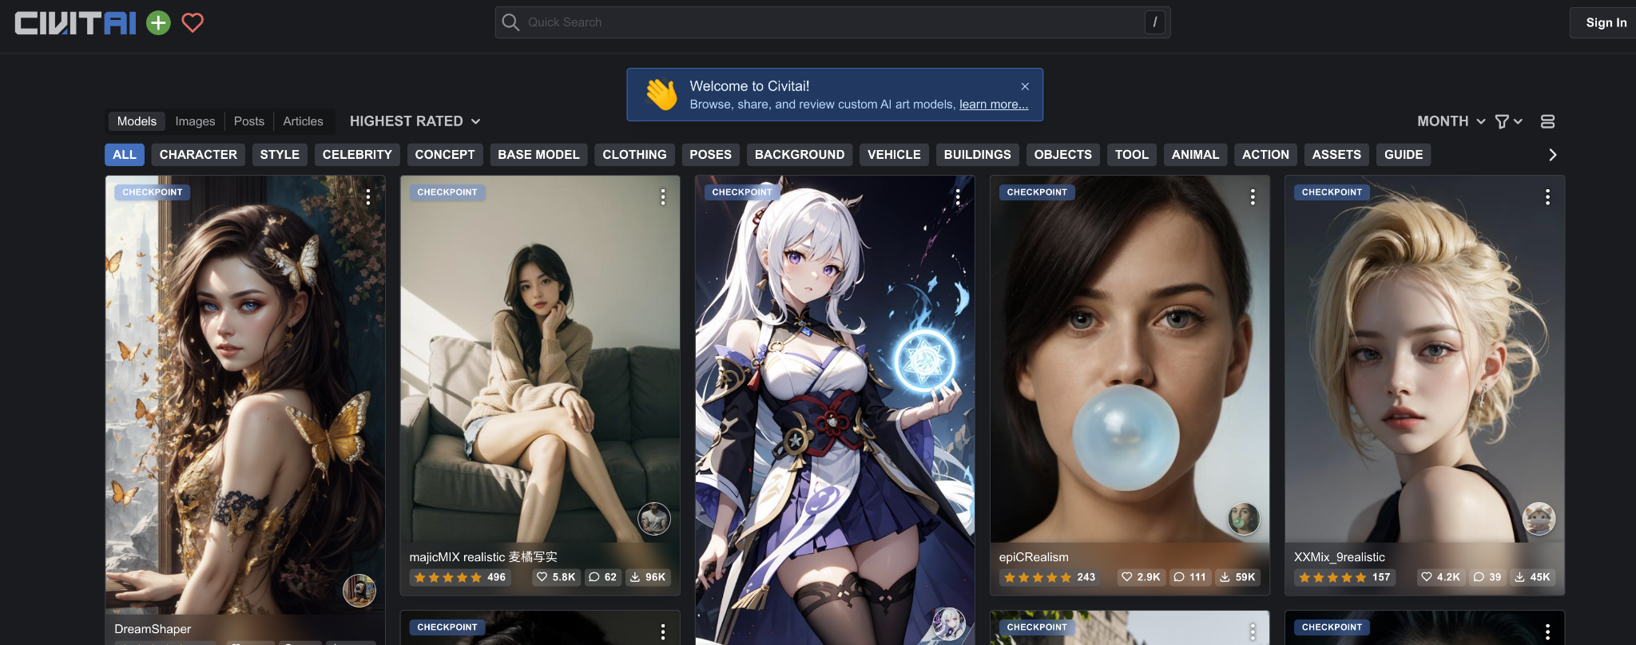
CIVITAI : Floodgates of Stable Diffusion
Model Zoo For Stable Diffusion
Public place to access Stable Diffusion Model: https://civitai.com/
Very Easy to Install and use.

Slide 14

CIVITAI : Model Zoo For Stable Diffusion
Warning: Some of the models: Might be Not Safe For Work
Test before Deploying to assess the distribution.
Quite a lot of categories available for models as:
Few Notable Models:

Slide 15
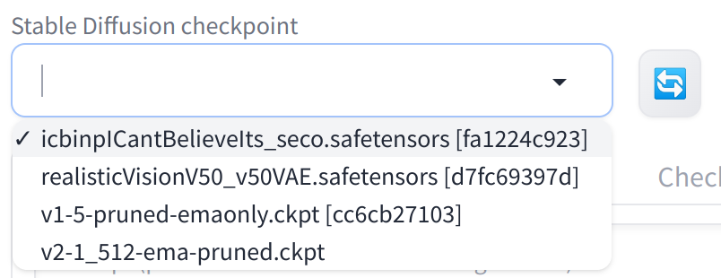
CIVITAI : Installation of Models
Run the below provided method from models/Stable-diffusion:
download_file(
'https://civitai.com/api/download/models/125411',
'realisticVisionV50_v50VAE.safetensors'
)
download_file(
'https://civitai.com/api/download/models/121557,
icbinpICantBelieveIts_seco.safetensors'
)
More user friendly way os installation of models in a bit.!

Slide 16
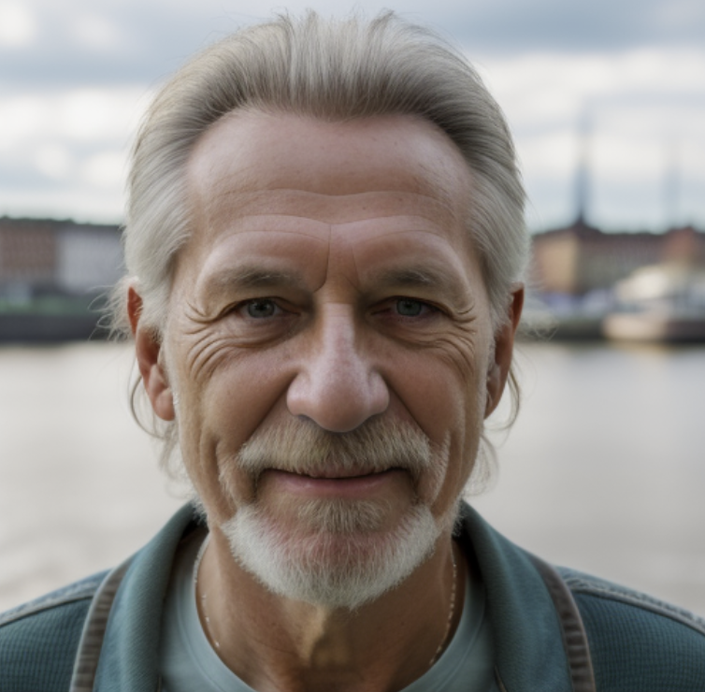
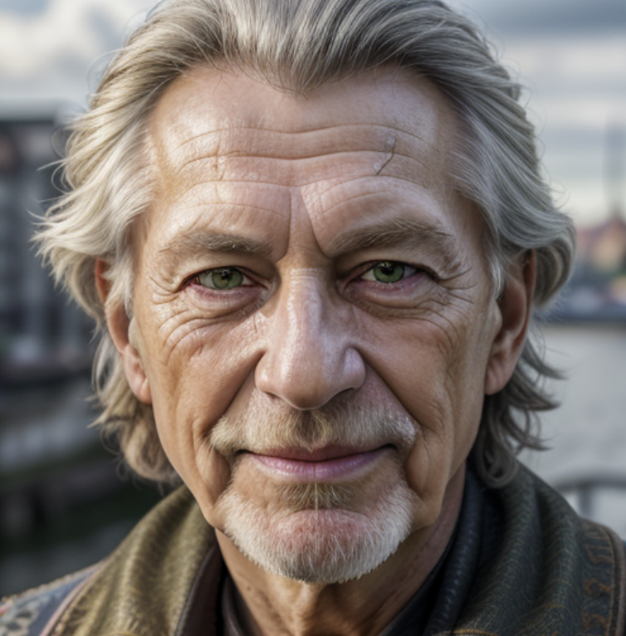
CIVITAI : Example Generations
Same prompt used for both models as below.
RAW photo, 8k UHD, high detailed skin, handsome german hippie, 72yo, bavarian man, green eyes, rule of thirds, masterpiece, photography, ultra realism, realistic, outdoors, golden hour, portrait, smiling, grey short hair, rocker style, DoF, (Hamburg:1.1), harbor, sky, clouds, soft lighting, ( highly detailed skin:0.7),(film grain:1.3), 8k uhd, dslr, soft lighting, high quality, HDRI, Fujifilm XT3 <lora:add_detail:0.66>

Slide 17
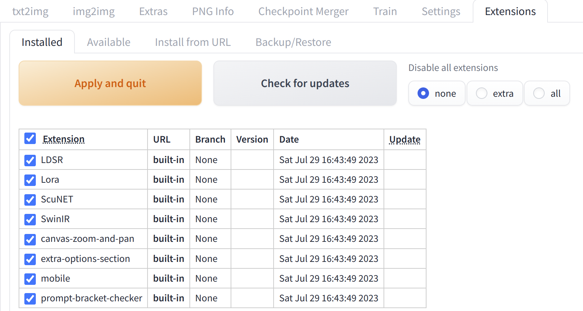
Stable Diffusion: Extensions
Easy way to extend the user experience of Stable Diffusion.
Enable it while starting the WebUI in share mode:
In Local mode, no need to enable is explicitly.
Extension Tab in WebUI ⇒

Slide 18
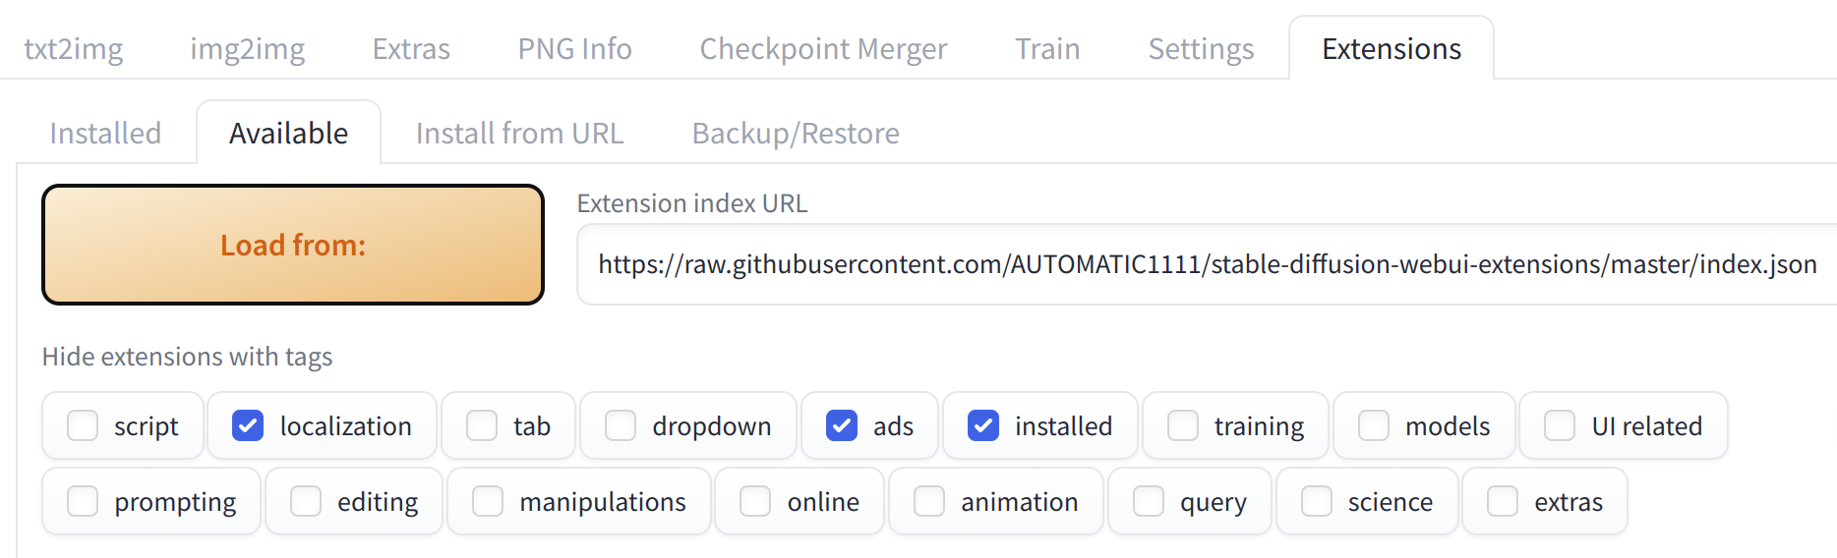
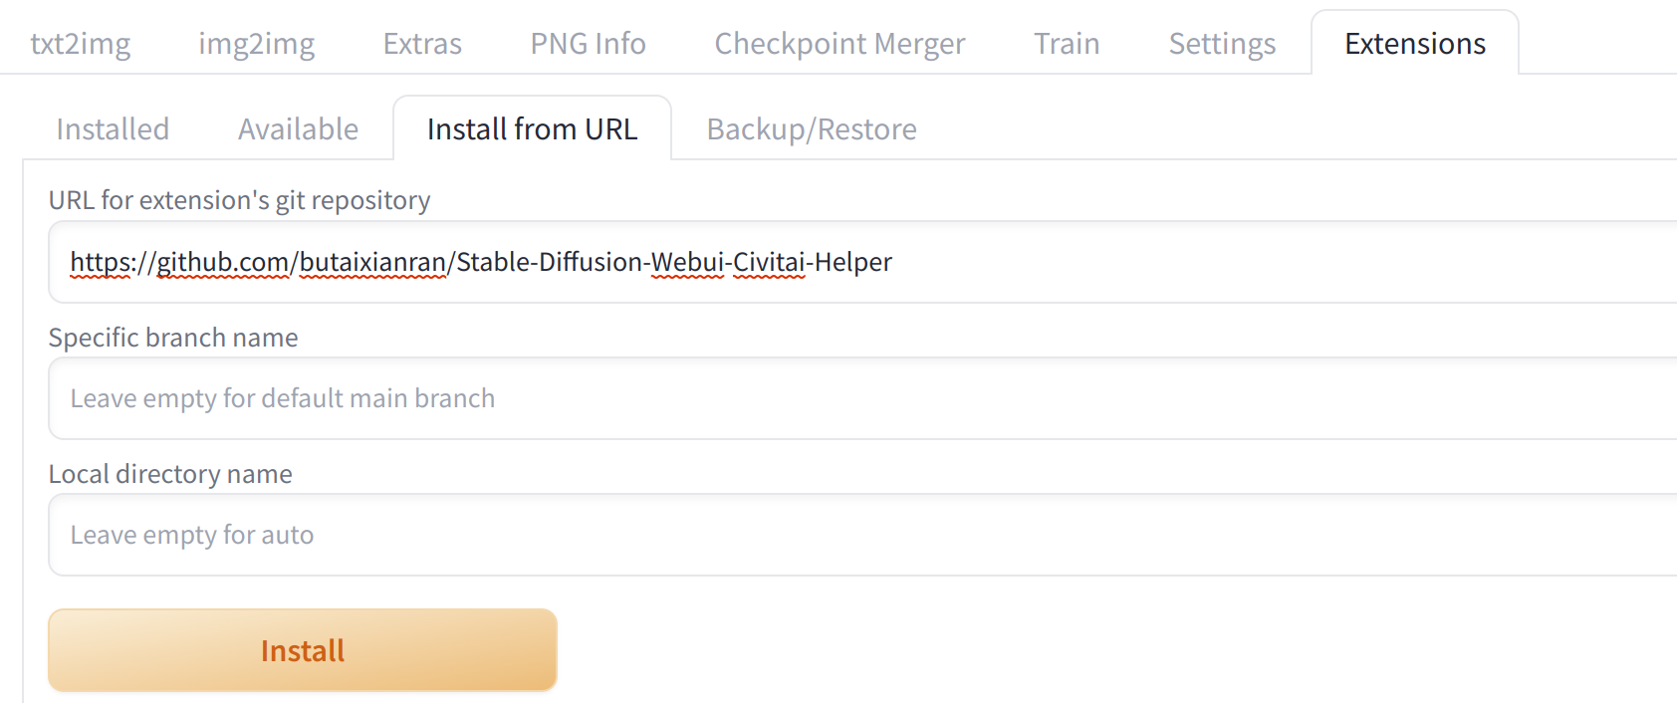
Stable Diffusion: Extensions Load/Install
Explore and Install from Stable-Diffusion core repo:
Install CIVITAI Extension to Install models easily:

Slide 19
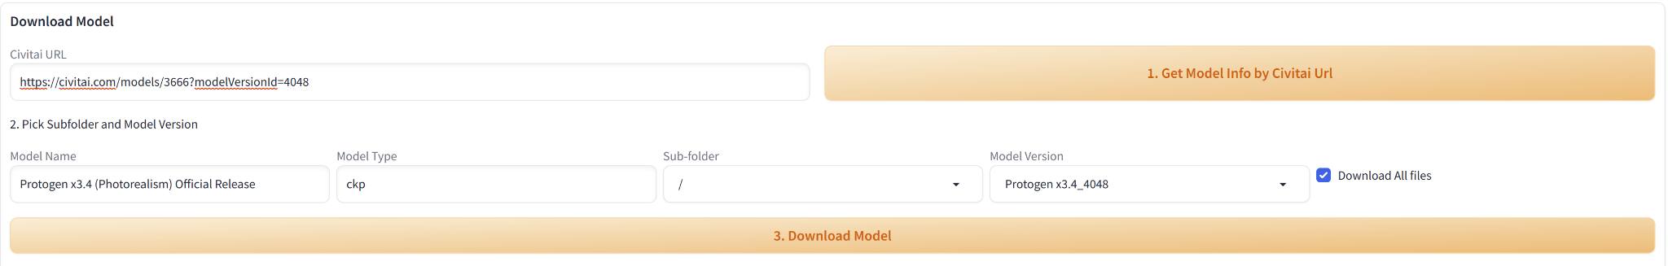
Stable Diffusion: CIVITAI Extension Use
One CIVITAI Helper is installed, We see new tab as:
Install CIVITAI Extension to Install models easily: Get the URL from browser from CIVITAI portal and use that to download the model.
This will install model at appropriate location, no effort to keep it integrated.
Model will become available into models dropbox after restart. Caution: If available use ‘safetensor’ type of model than ckp(checkpoint file)

Slide 20
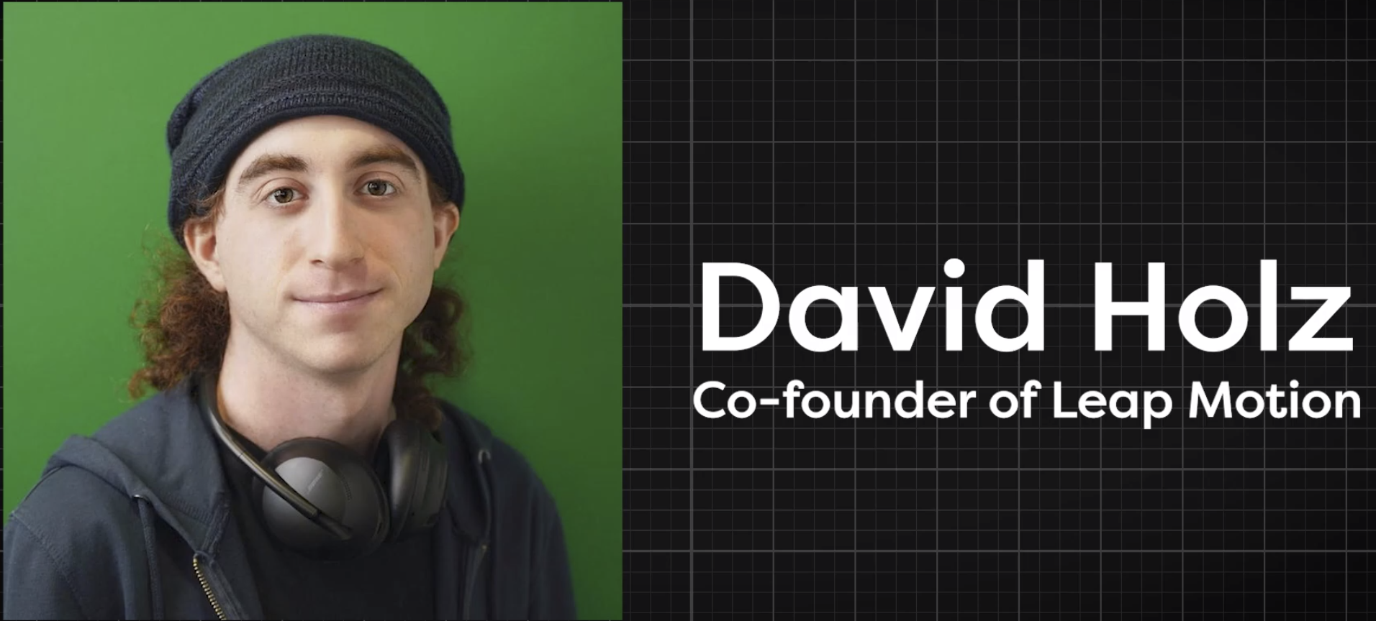


MidJourney: The Stable Diffusion Storm
Phenomenal Growth in 12 months.
Very Artistic and Dreamy.
Referred as “Mid Journey Touch”
Discord based server interface.
Many different models are available and released often.
Most Preferred in term of quality, but others are catching up!

Slide 21
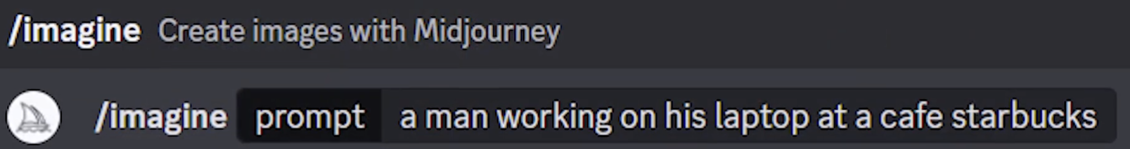
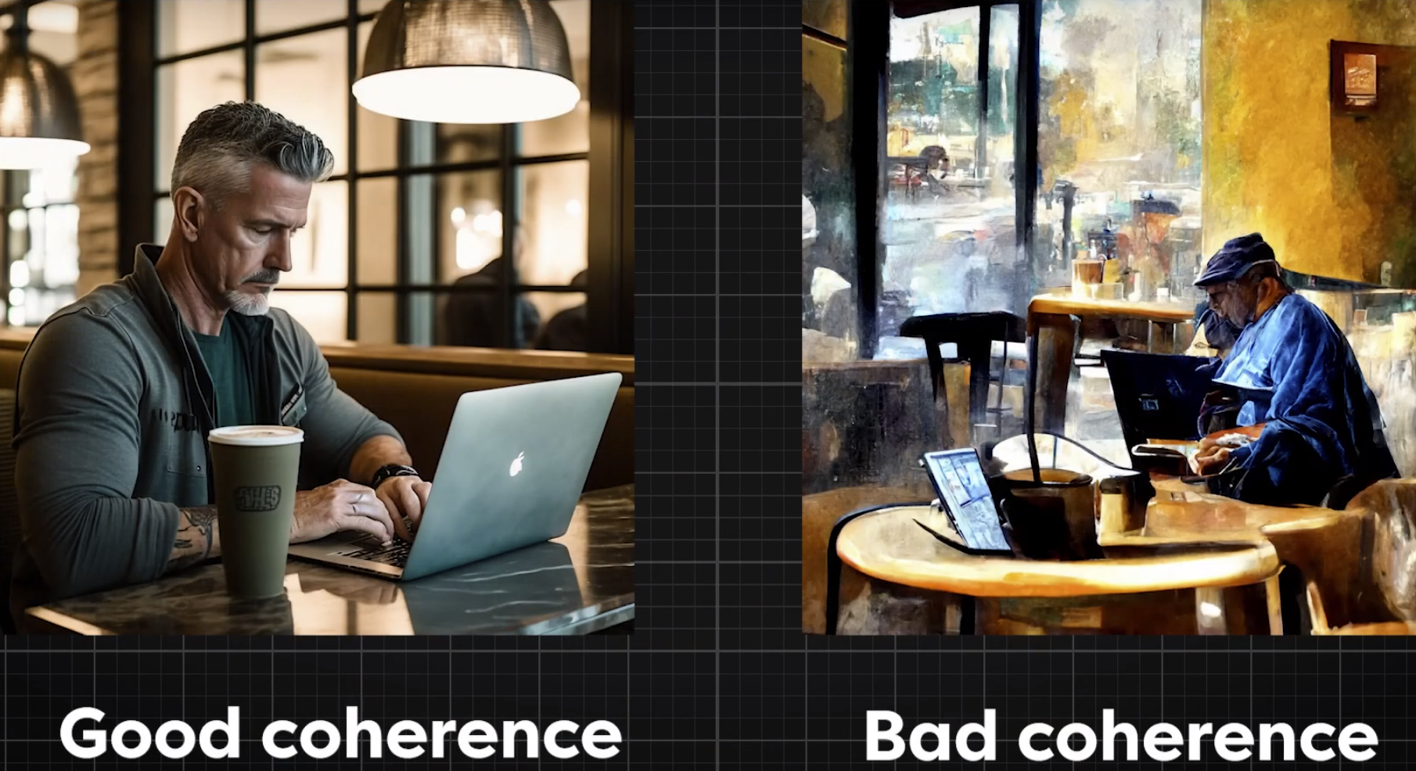
MidJourney: Key Concepts
Text prompt interface :
Coherence: How well image matches the text prompt.

Slide 22
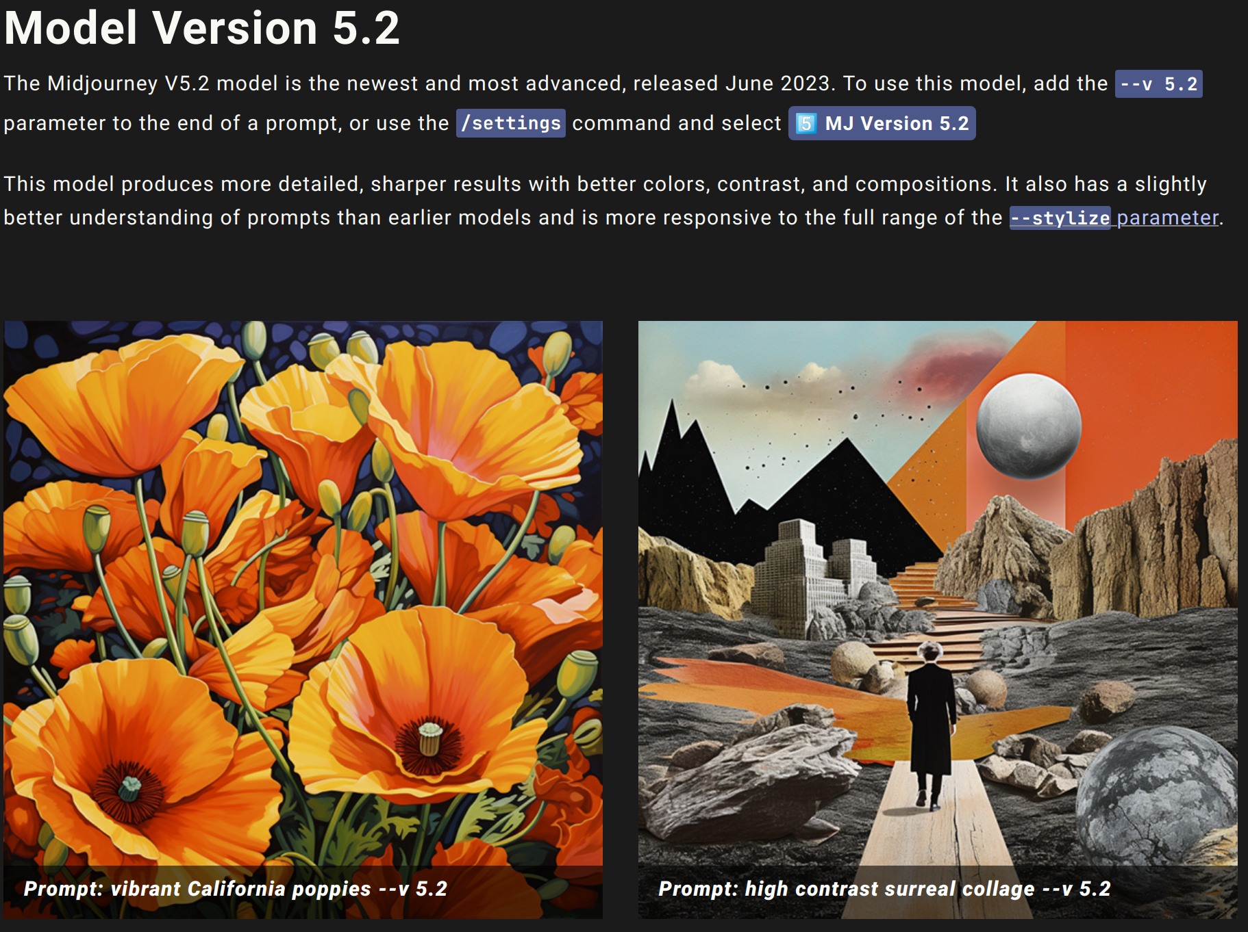
MidJourney: Model Versions
Following model versions available:
Latest model is: 5.2, which is Stunning!

Slide 23
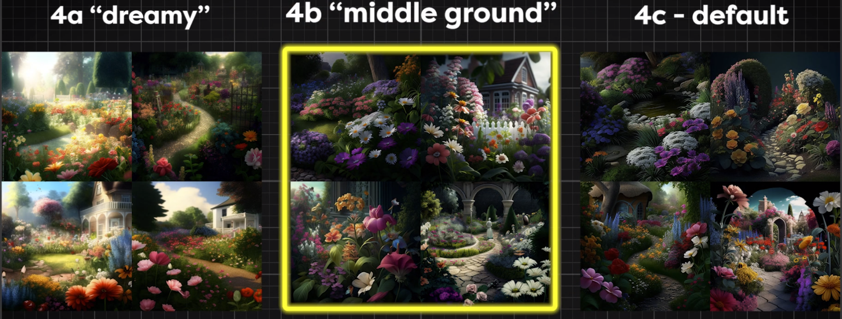
MidJourney: Style Parameters
Mid Journey offers many styles, which are very useful for the purpose at hand.

Slide 24



MidJourney: Join and Use
Join either through web browser or discord app. Channel to join is:
Largest Discord Server. Imagine that!
Many prompts to use starting with ‘/’
Used to free to generate images, But paid now:
Go to any newbies-XXX channel.
Generate Images as:
/imagine tag will return your generated images.

Slide 25
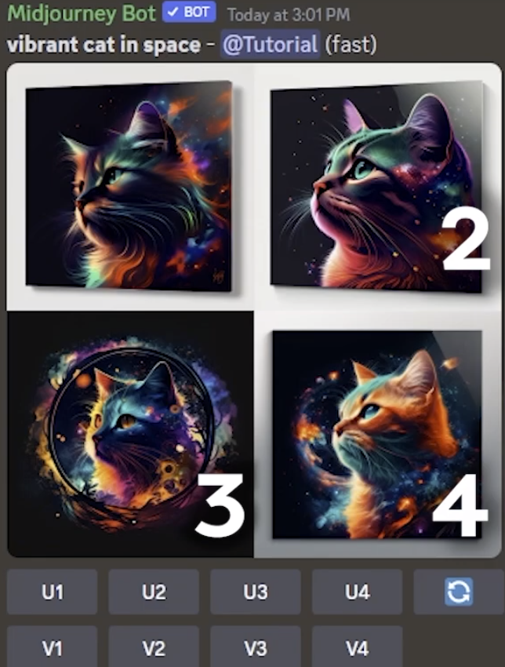
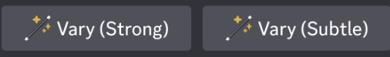
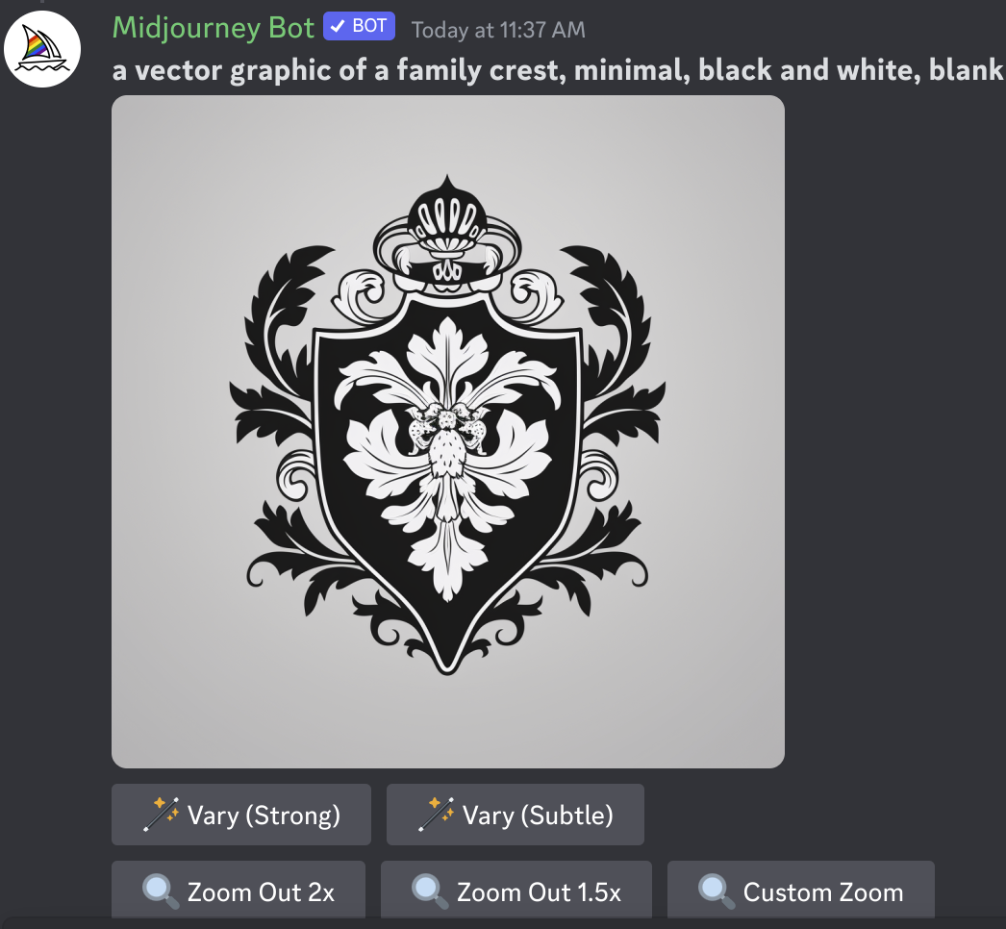
MidJourney: Post Processing Results
You can create Variations of generated image very easily by button on the bottom of image:
Variation can be created using:
Zoom Features are Awesome:
Documentation is available at: https://docs.midjourney.com/docs/
Various Upscaling and Variation options available.

Slide 26
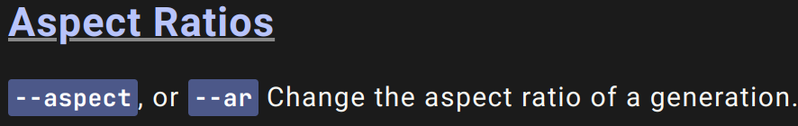
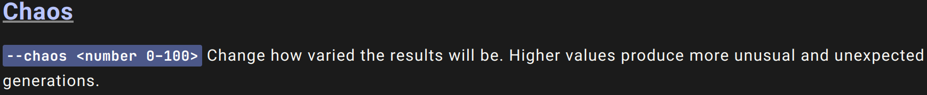
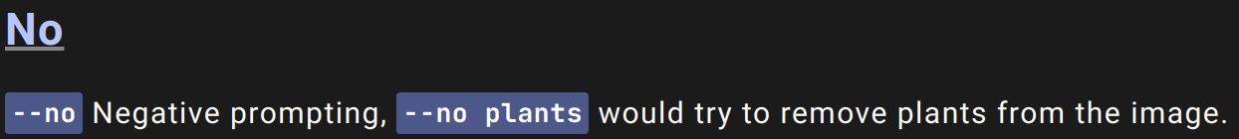
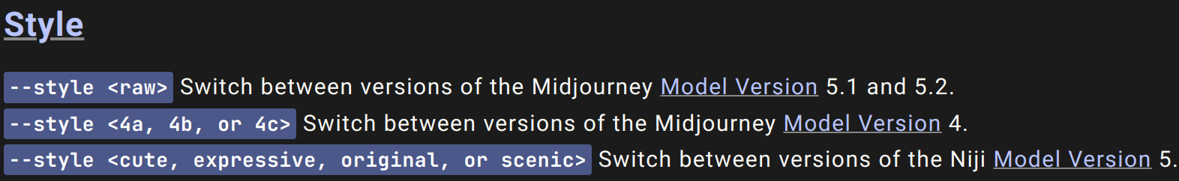
MidJourney: Parameters
Most Extensive Set of Parameters!
Few important parameters are:
Unusual Parameter name:
--Weird <number 0–3000> Explore unusual aesthetics with the experimental

Slide 27
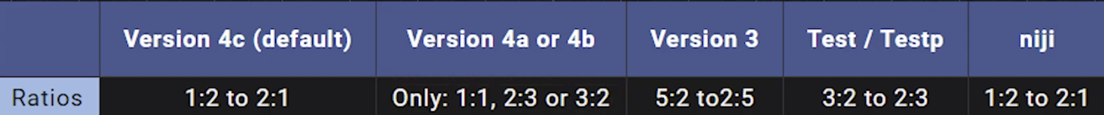
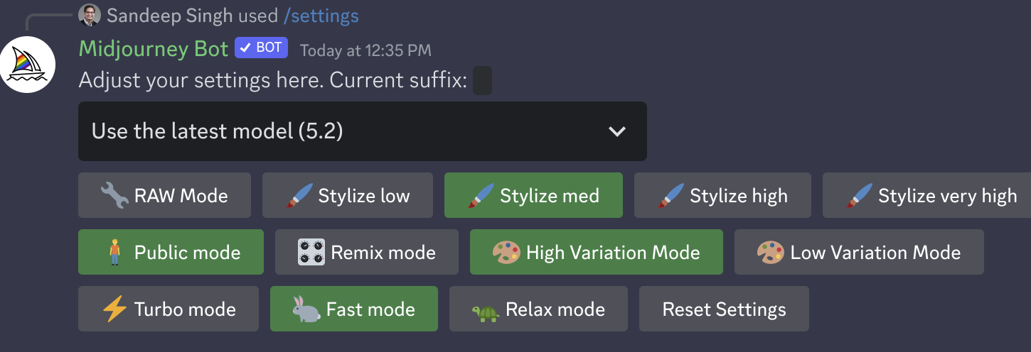
MidJourney: Settings
Note that not all the aspect ratios are not available for all the models:
Lots of setting to play around with /settings prompt:

Slide 28
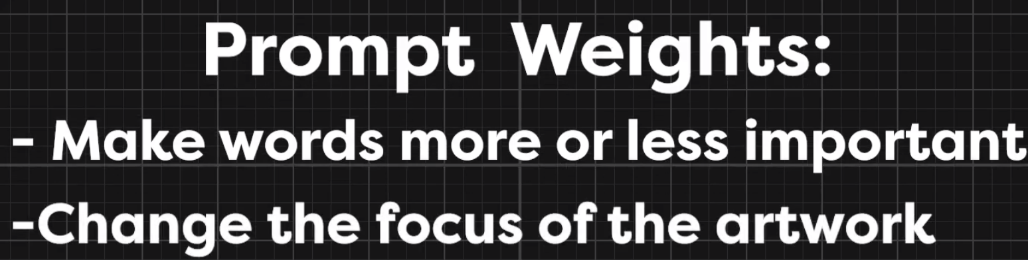
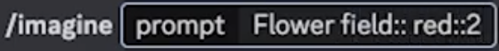
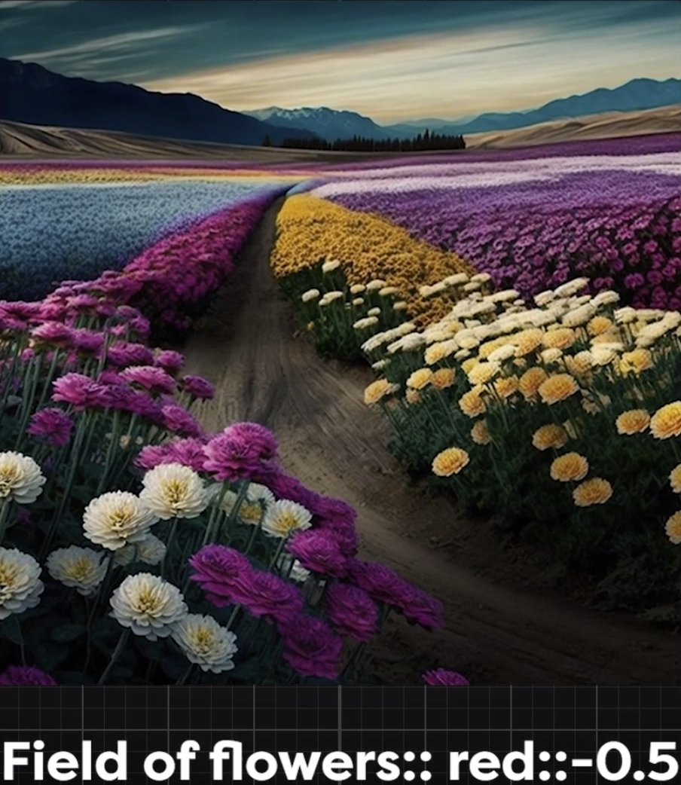
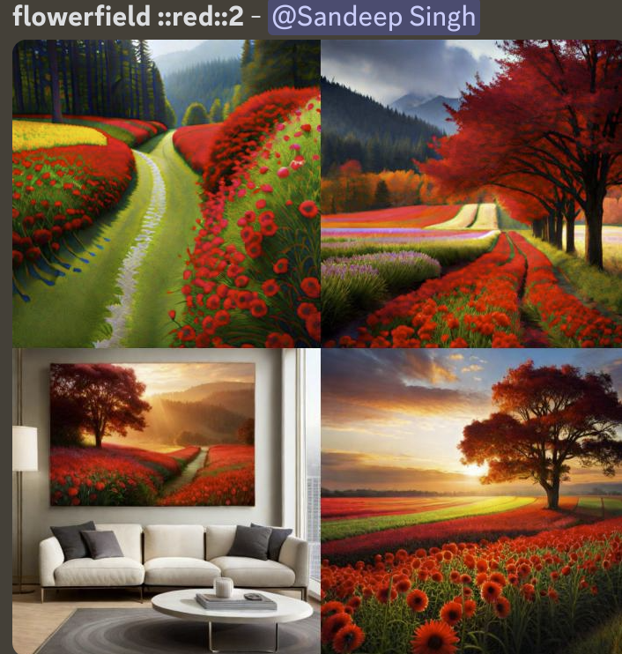
MidJourney: Prompt Weights

Slide 29
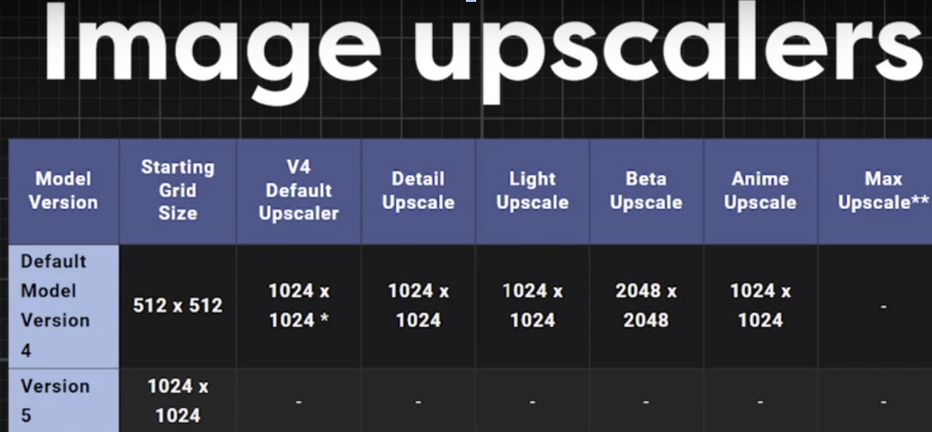
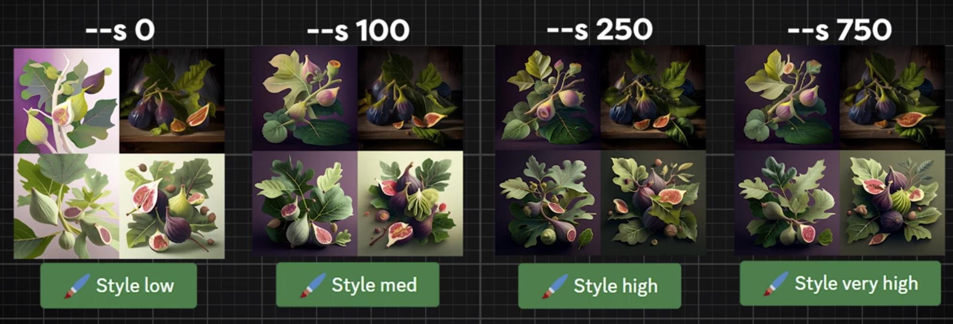
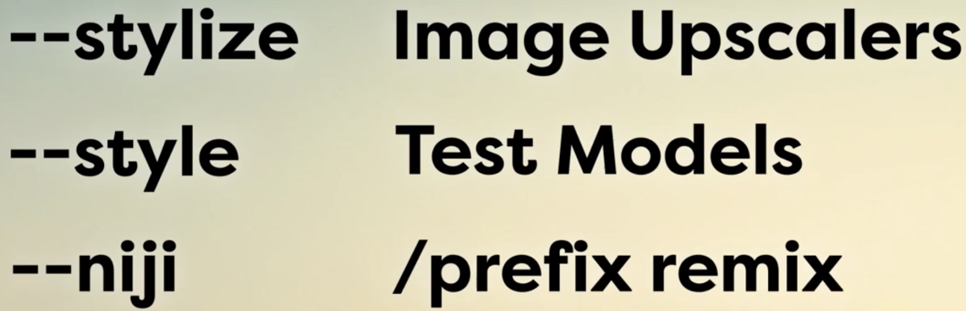
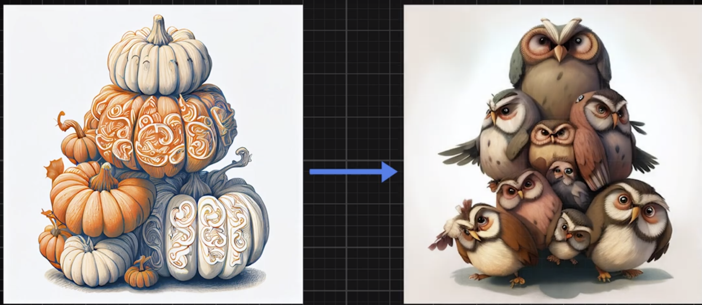
MidJourney: Advanced Features
Remix option is amazing.

Slide 30
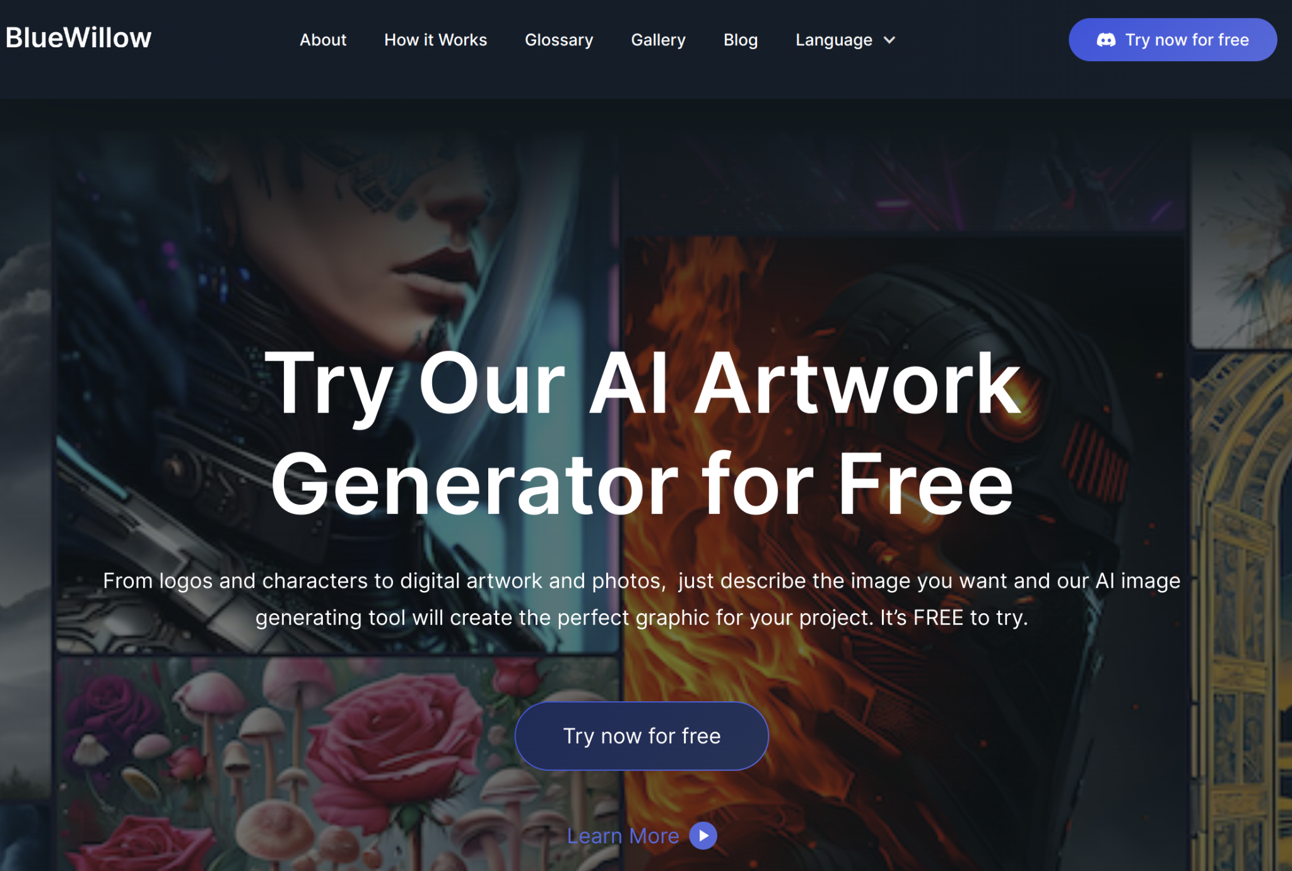
Blue Willow: Best MidJourney Alternative
Models are as good as MidJourney in a lot of sense.
Free to use as of now.
More frequent updates since last few months.
Again, Discord based familiar User Experience.
Warning: Publicly available information and NSFW.

Slide 31
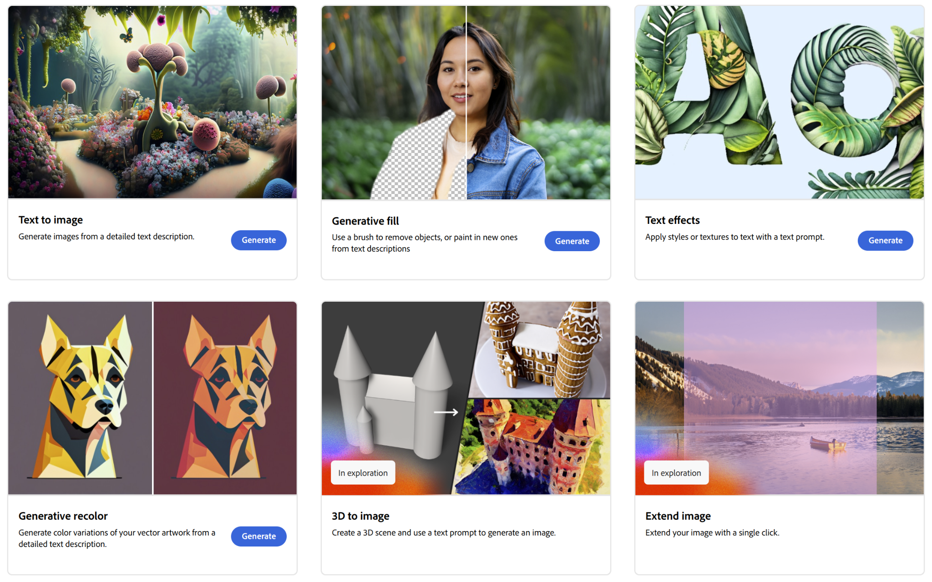
Adobe Firefly: Much more controlled/Safe
Very versatile in usage.
Safe for students and kids.
Options and UI based generation options.
One of the Few publicly available 3D models to Image Generation platform.

Slide 32

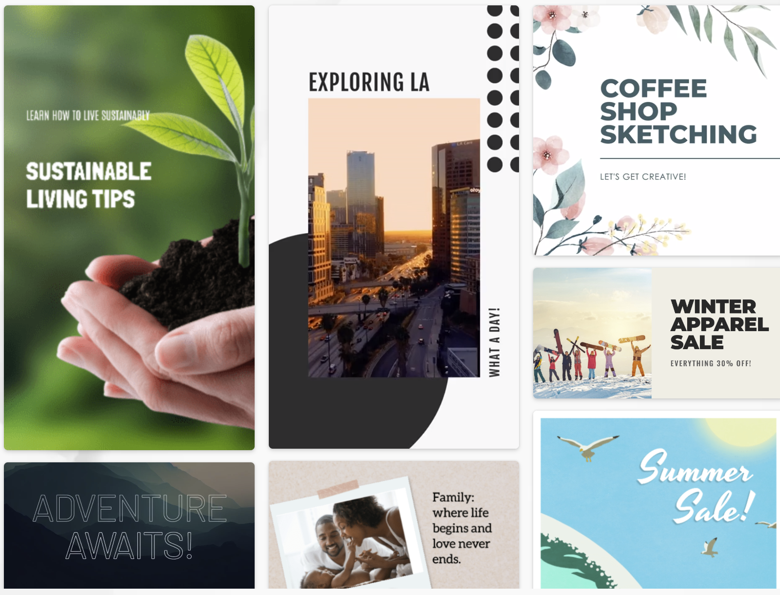
Microsoft Designer: Ease of Use
Available at: https://designer.microsoft.com/
More Designer friendly.
Great for day to day use of life.
Options and UI based generation options.

Slide 33
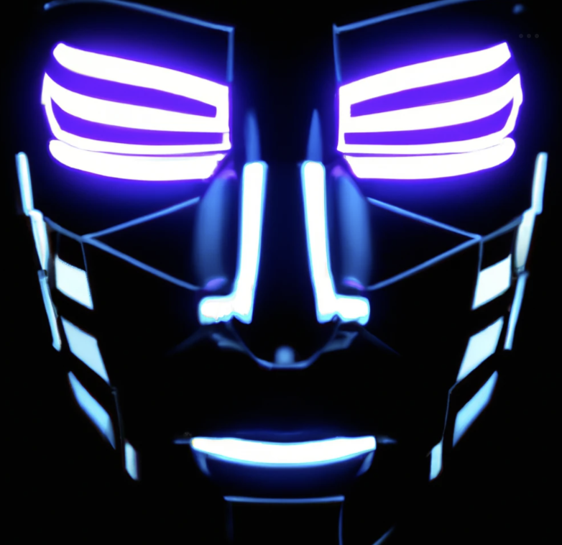

OpenAI Dall-E2: Well You know it
Available at: https://labs.openai.com/
First to do Text to Image.
Many more guardrails.
Safe to use.

Slide 34
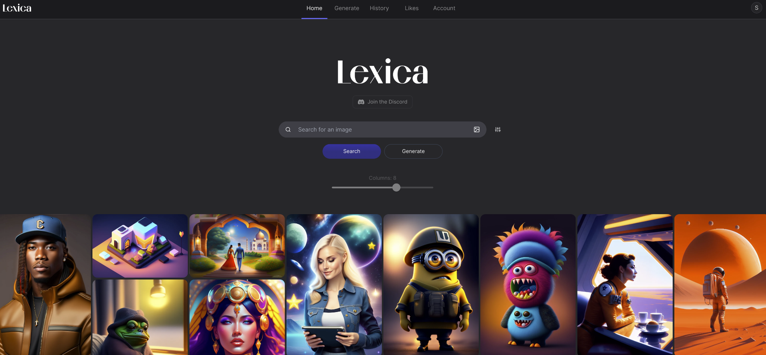
Lexica Art Project: Learn to Prompt
Available at: https://lexica.art/
Lots of example to search and use the prompts for text to image models.
Option to generate image in browser.
Sometime it is slow as per geography and demand.

Slide 35

Questions?

Slide 36

!

